Slide 1
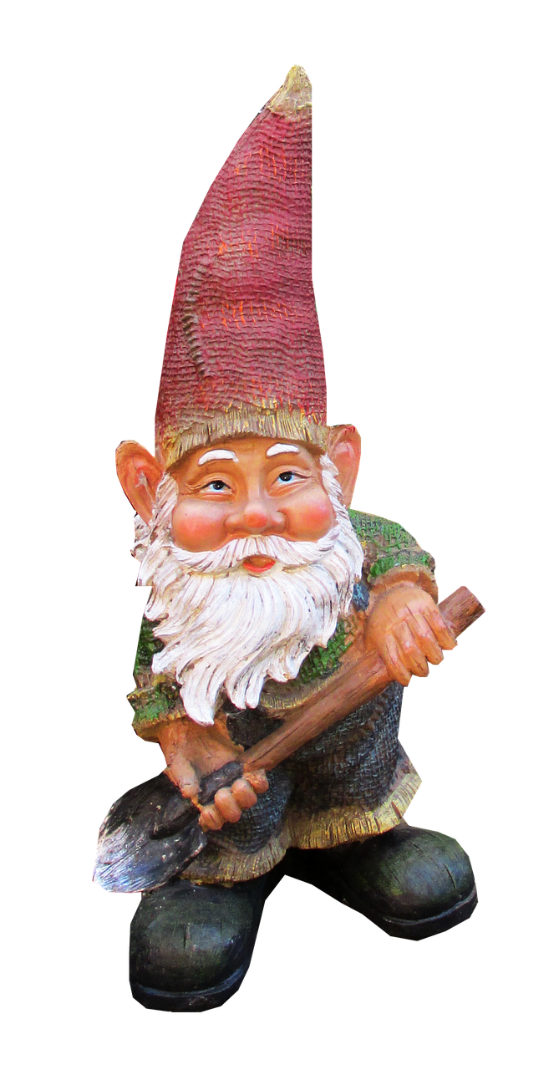

Place for Space
The first ever long and short-term
rental management service
Brought to you by:
Tanner Hay,
Connor Stacey,
Nona Anderson,
Adam Martinez

Slide 2
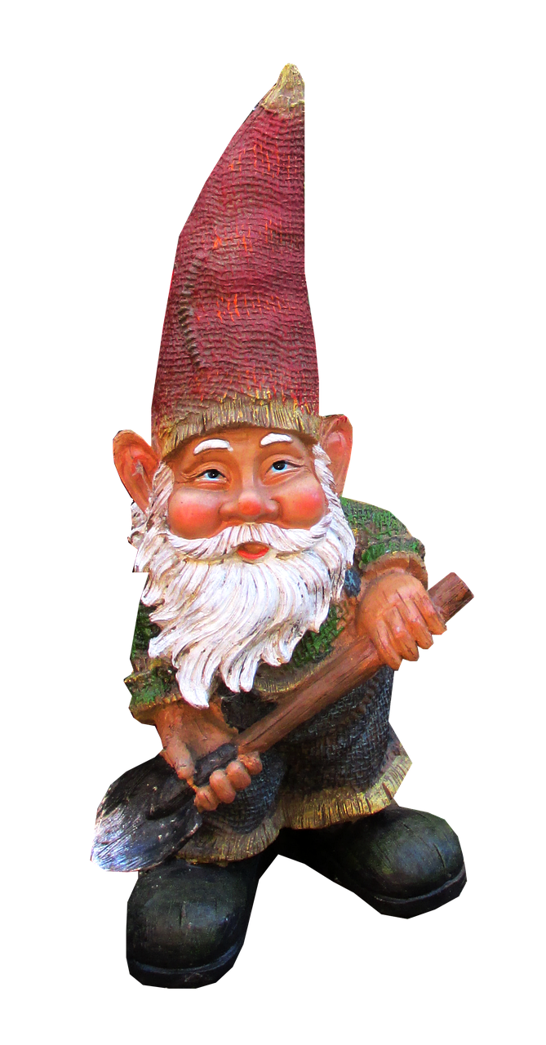
Name | Role | Project Activities
Connor Stacey | Functional Project Lead | Timeline Organization, Database Lead
Nona Anderson | Management Lead | Team and Documentation Organization, Design
Adam Martinez | Technical Lead | Determine best course of action to meet feature goals
Tanner Hay | Lead Developer | Head approach on all development standards
Meet the Team
Notes:
I’m Connor, I’m the functional project lead, and this is the rest of our team: Nona, our management lead; Adam, our technical lead; and Tanner, our lead developer

Slide 3
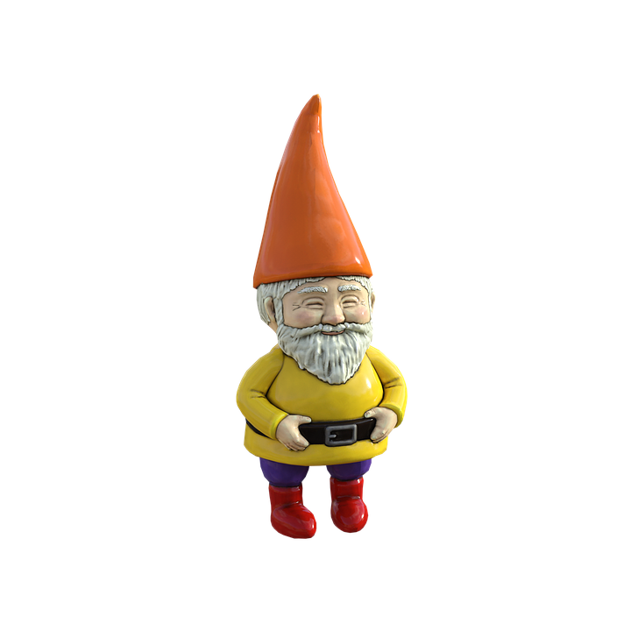
Place for Space was created to bring a sense of coherence and ease to your renting and leasing needs
Why Rentals?
Notes:
The renting process, whether for your home or vacation can be complicated and stressful, we aim to make that process as smooth as possible

Slide 4
Airbnb has issues with late cancellations and false listings
Vacation and rental sites are seperate
Problem
Notes:
Interacting with complicated processes across multiple sites can slow down your day and take the fun out of your search. Not to mention dealing with controversies and issues plaguing market leaders like AirBnB

Slide 5

We offer BOTH on one platform
Late cancellations are not tolerated
Each listing is carefully checked by our team of sewer gnomes
Solutions
Notes:
At Place for Space, we’re providing solutions. We want to be your one stop shop for rental needs. A place you can trust. Our team is working hard to ensure that there are no late cancellations and no fake listings.

Slide 6






o
Chat functionality
Google Maps integration
Login/registration
Comprehensive search
Multimedia
Special
Features
Notes:
We’ll provide users with all the tools they need to find their next rental space. Using Heroku to host the site, OAuth to manage user registration, nodejs for the backend, react for the front end, and PostgresSQL for the database work. We provide a personalized account, ways to communicate with other users, and more all easily accessible from the dashboard.

Slide 7





Tech
Stack

Slide 8
Users pay a small fee when renting or listing
Advertisements
According to BusinessofApps.com AirBnB made $4.7 billion in 2019
Business
Model
Notes:
How will we make money? Simple, all users will pay a small fee to ensure the quality of place for space while listers in particular can pay for advertising for their properties. According to a review by BusinessofApps.com, AirBnB made just under 5 billion dollars in 2019. Even with a quarter as many listings, we could expect to see a billion dollars in revenue in our first fiscal year

Slide 9
Sprint 1
Login with OAuth
Landing Page
Sprint 2
Progress
Projection
Search
Sprint 3
Maps and MultiMedia
Sprint 4
Chat Function
Sprint 5
Admin Dashboard
Notes:
Over the course of our 5 sprint plan, we will implement these features providing a functioning deliverable at the end of sprint 5

Slide 10

Task | Complete By
Familiarize with HTML, OAuth | 02/18
User Registration/Login Page | 03/01
Dashboard/Landing Page | 03/01
Search Functionality | 03/15
Next Steps
Notes:
Remember that sprint plan? Here’s another breakdown of those completion dates coming up

Slide 11

?
Questions
How many Gnomes did you count?

